Slide 1
DIABETIC KETOACIDOSIS PROTOCOL
2024 REVISION
www.bcchildrens.ca/endocrinology-diabetes-site/documents/dkaslides.pptx
Notes:
1

Slide 2
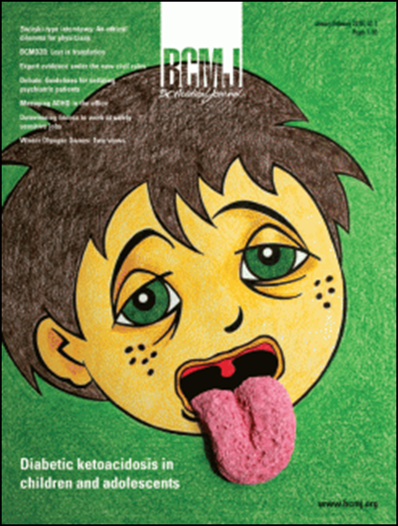
DIAGNOSIS OF DKA
hyperglycemia: blood glucose >11.1 mmol/L
acidosis: venous pH <7.3 or HCO₃– <18 mmol/L
ketones:
plasma β-hydroxybutyrate ≥3 mmol/L
moderate–large ketonuria (≥2+)
~10–20% of kids with new-onset T1D present in DKA
DDx: hyperglycemic hyperosmolar state

Slide 3
SEVERITY OF DKA
 | pH | HCO₃–
mild | <7.3 | <18
moderate | <7.2 | <10
severe | <7.1 | <5

Slide 4
DKA: PATHOPHYSIOLOGY
metabolic effects of insulinopenia
↓ glucose uptake into muscle, fat, liver
↑ gluconeogenesis, ↑ glycogenolysis, ↑ lipolysis, ↑ ketogenesis
hyperglycemia, obligate diuresis
↑ stress hormones aggravate situation
metabolic acidosis: ketones, lactate
huge losses of H₂O, Na⁺, K⁺, HCO₃–, P_{i}

Slide 5
RATIONALE FOR 2024 REVISION
The PECARN FLUID Trial demonstrated that fast vs slow rehydration for DKA seems to be equivalent with respect to:
brain injury (0.9%)
short-term memory
post-event memory
IQ
serious adverse events
some suggestion (not significant) that faster rehydration:
led to less ↓ in GCS
led to faster ↑ in short-term memory scores in sickest patients

Slide 6
DKA PROTOCOL 2024: GENERAL PRINCIPLES
20 mL/kg fluid push over 30 min, repeat if CV status not improved
assume 5–10% dehydration (7% for most)
even rehydration over 24–36 h
use of 0.45–0.9% NaCl-containing fluids
avoid use of bicarbonate
no insulin in the 1–2 h of treatment
continuous insulin infusion, glucose to match
continued use of the “two-bag” method

Slide 7
MODIFICATIONS FROM 2019 PROTOCOL
a plasma HCO₃– <18 mmol/L is now diagnostic of DKA (previously, the cut-off was 15 mmol/L)
more-aggressive fluid boluses are suggested at the start of therapy:
most patients with DKA should receive a 20-mL/kg bolus of normal saline over 30 min at the initiation of treatment
repeated 20-mL/kg boluses may be required for circulatory compromise
notation is added not to begin KCl unless patient is urinating and has plasma K⁺ ≤5.5 mmol/L
notation is added not to begin insulin unless plasma K⁺ ≥3.5 mmol/L
an insulin infusion rate of 0.05 U/kg/h is suggested when pH >7.15

Slide 8
DKA PROTOCOLS: DISCLAIMER
no DKA protocol has been shown to eliminate the risk of cerebral injury
current gold standard: ISPAD Clinical Practice Consensus Guidelines 2022
guidelines should not replace intelligent thought and should be tailored to meet the needs of each individual patient
involve Pediatric Endocrinology early!
Pediatric Diabetes 2014;15(Suppl 20):154–179

Slide 9
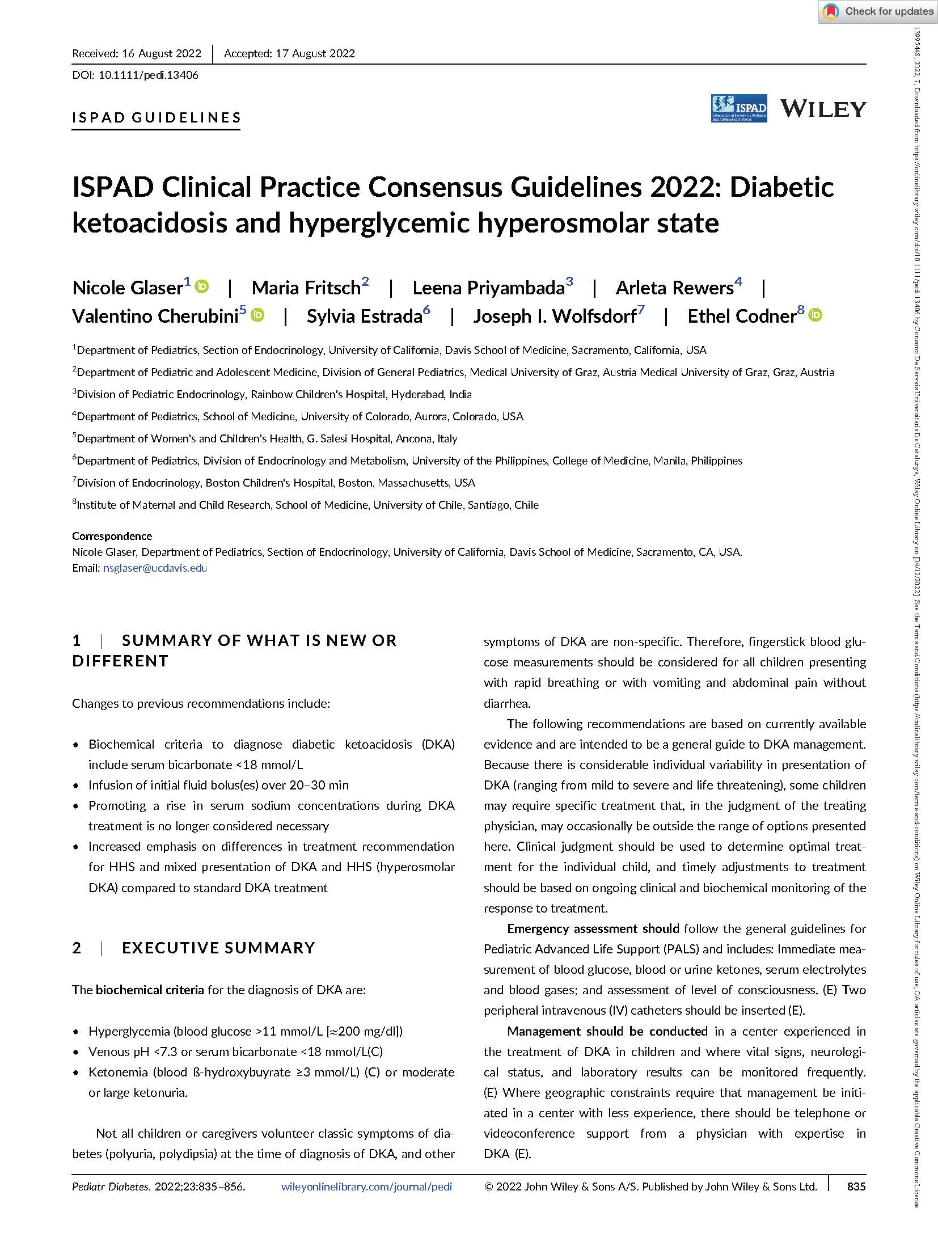
ISPAD 2022

Slide 10
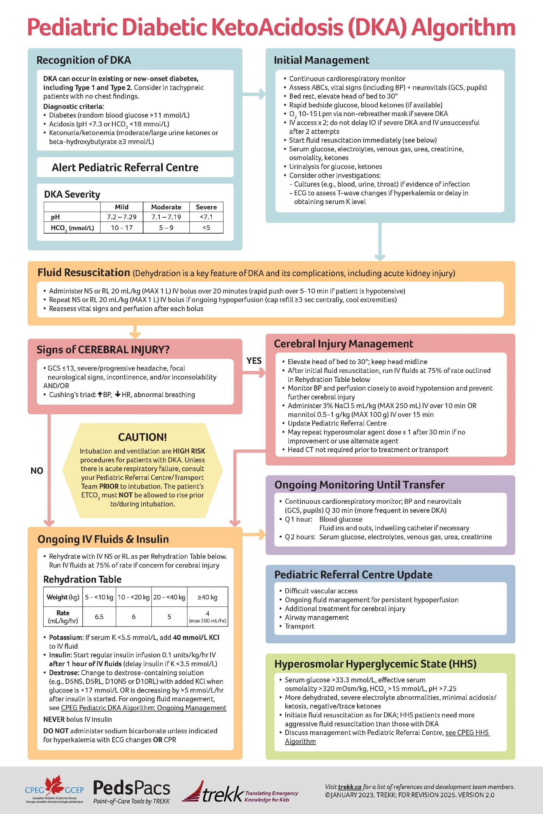
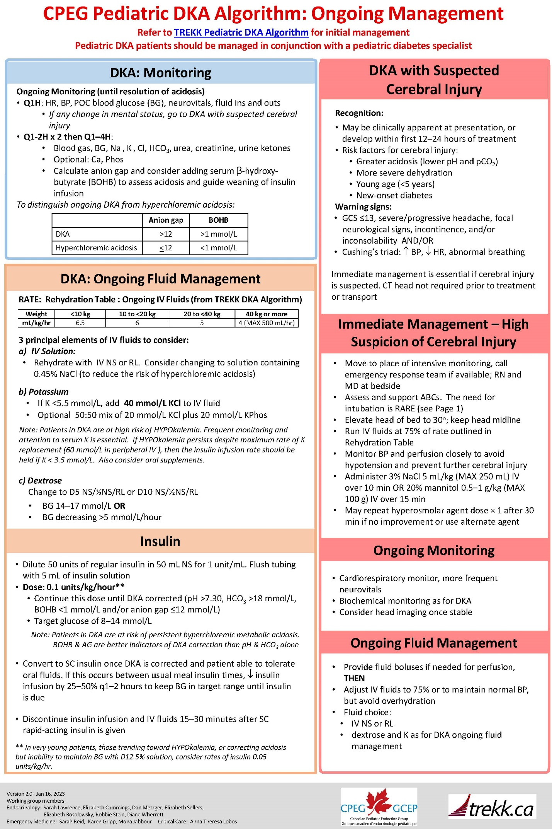
TREKK 2023

Slide 11
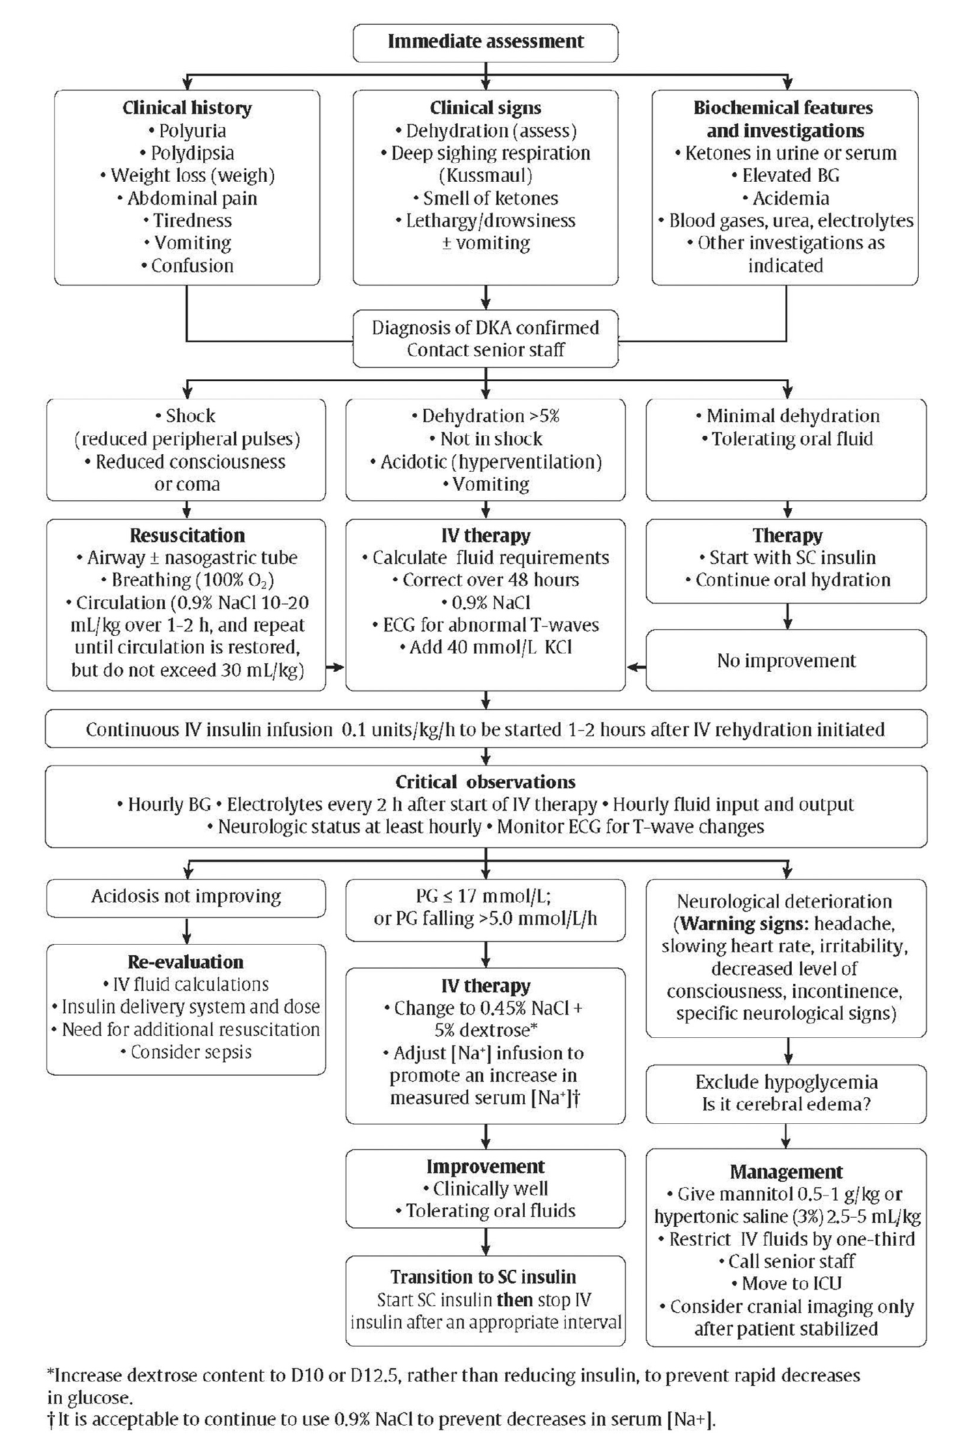
DIABETES CANADA 2018

Slide 12
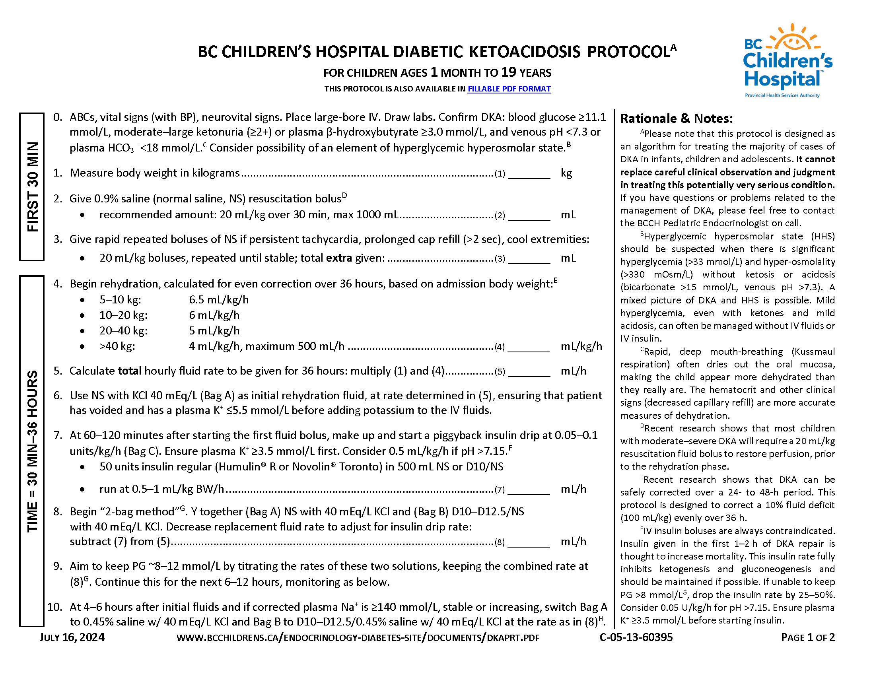
2024 BCCH DKA PROTOCOL

Slide 13
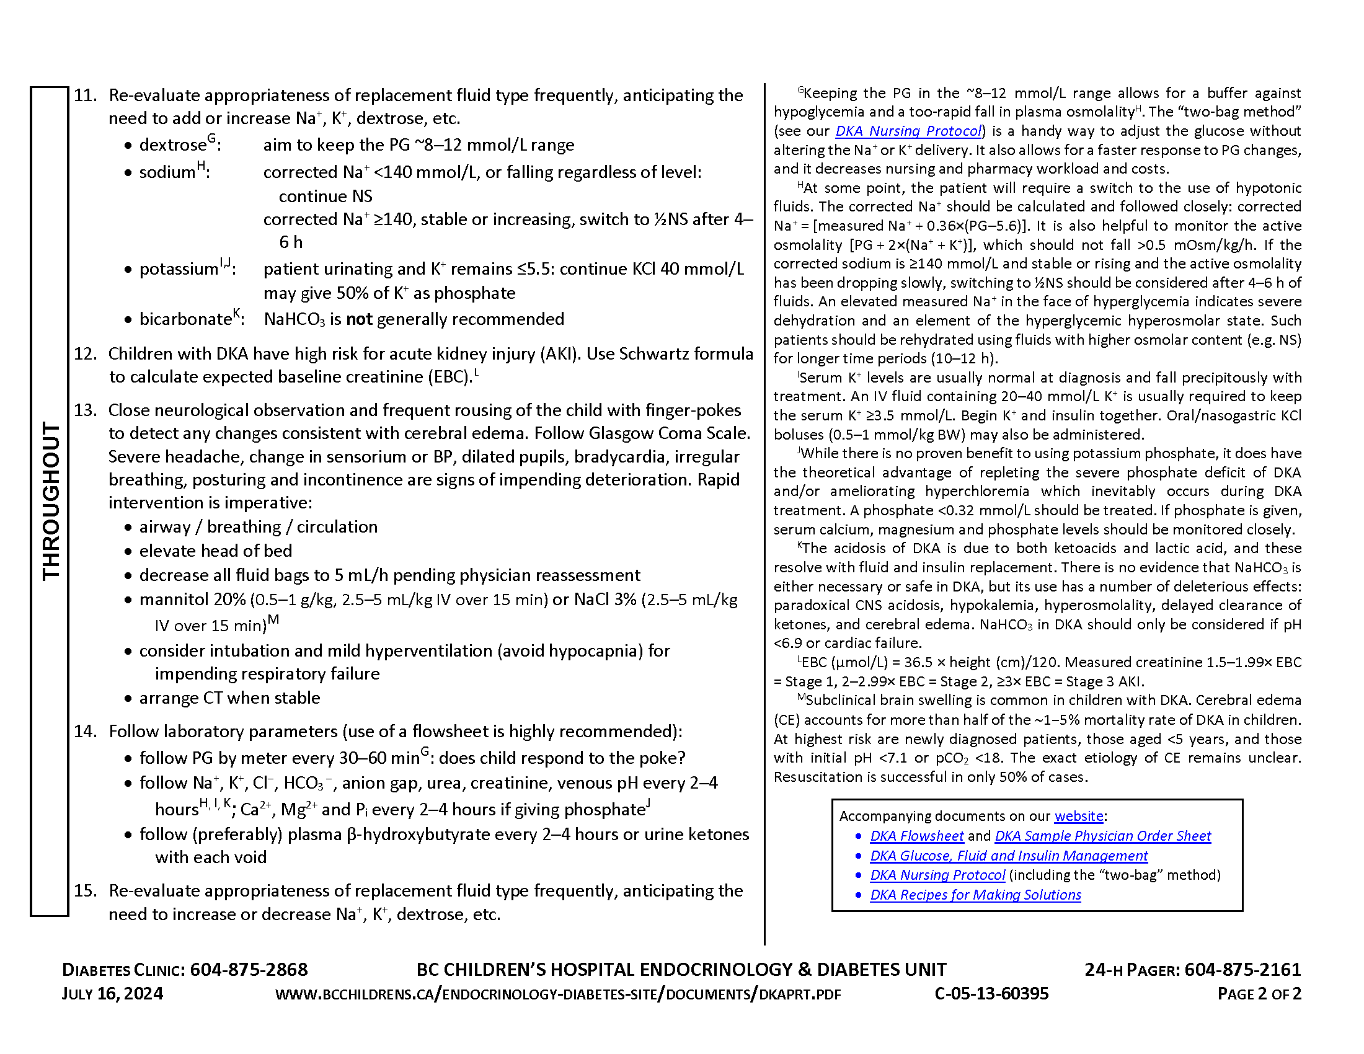
2024 BCCH DKA PROTOCOL

Slide 14
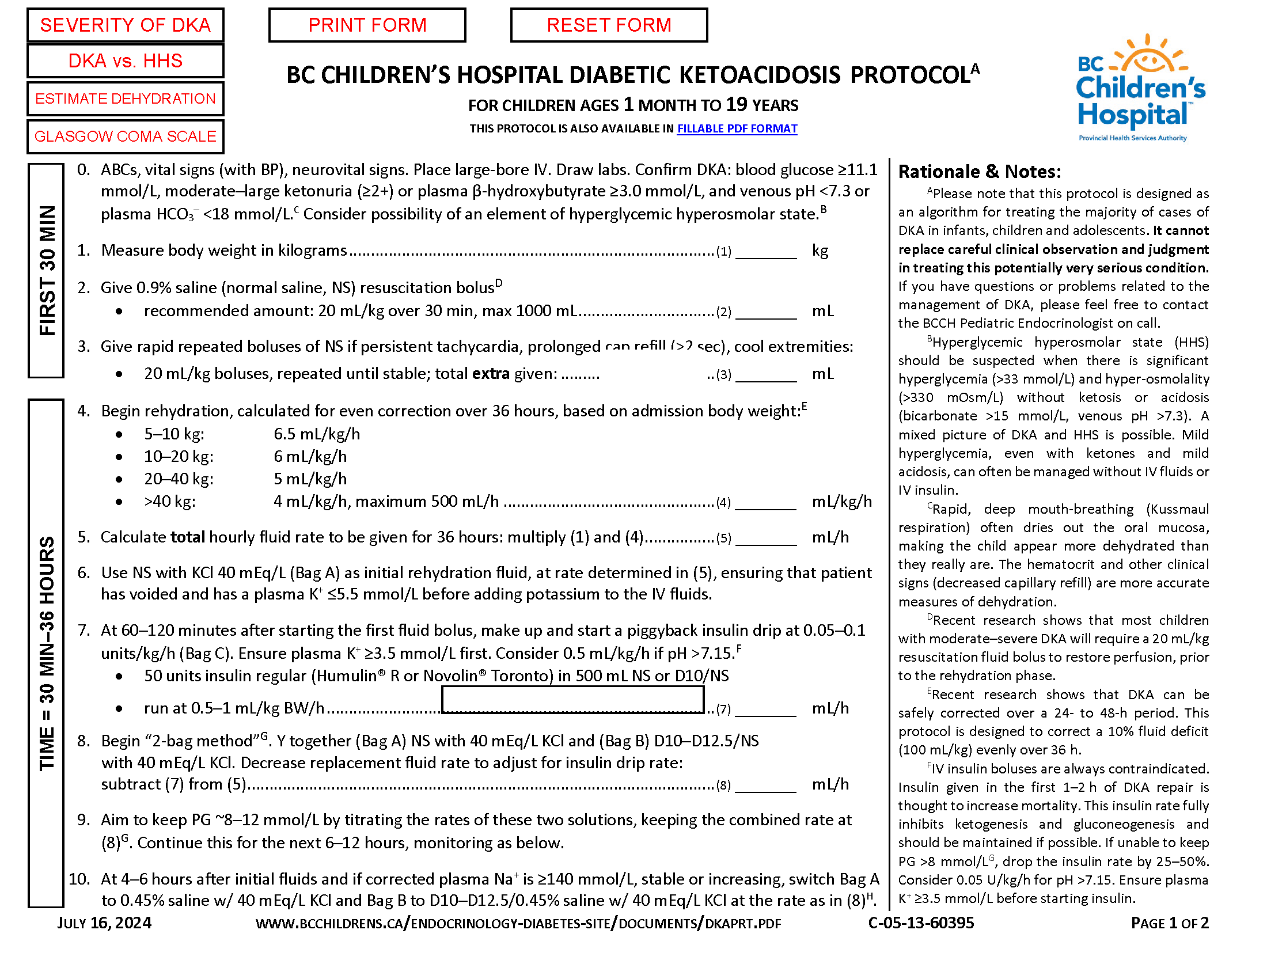
2024 BCCH DKA PROTOCOL – FILLABLE

Slide 15
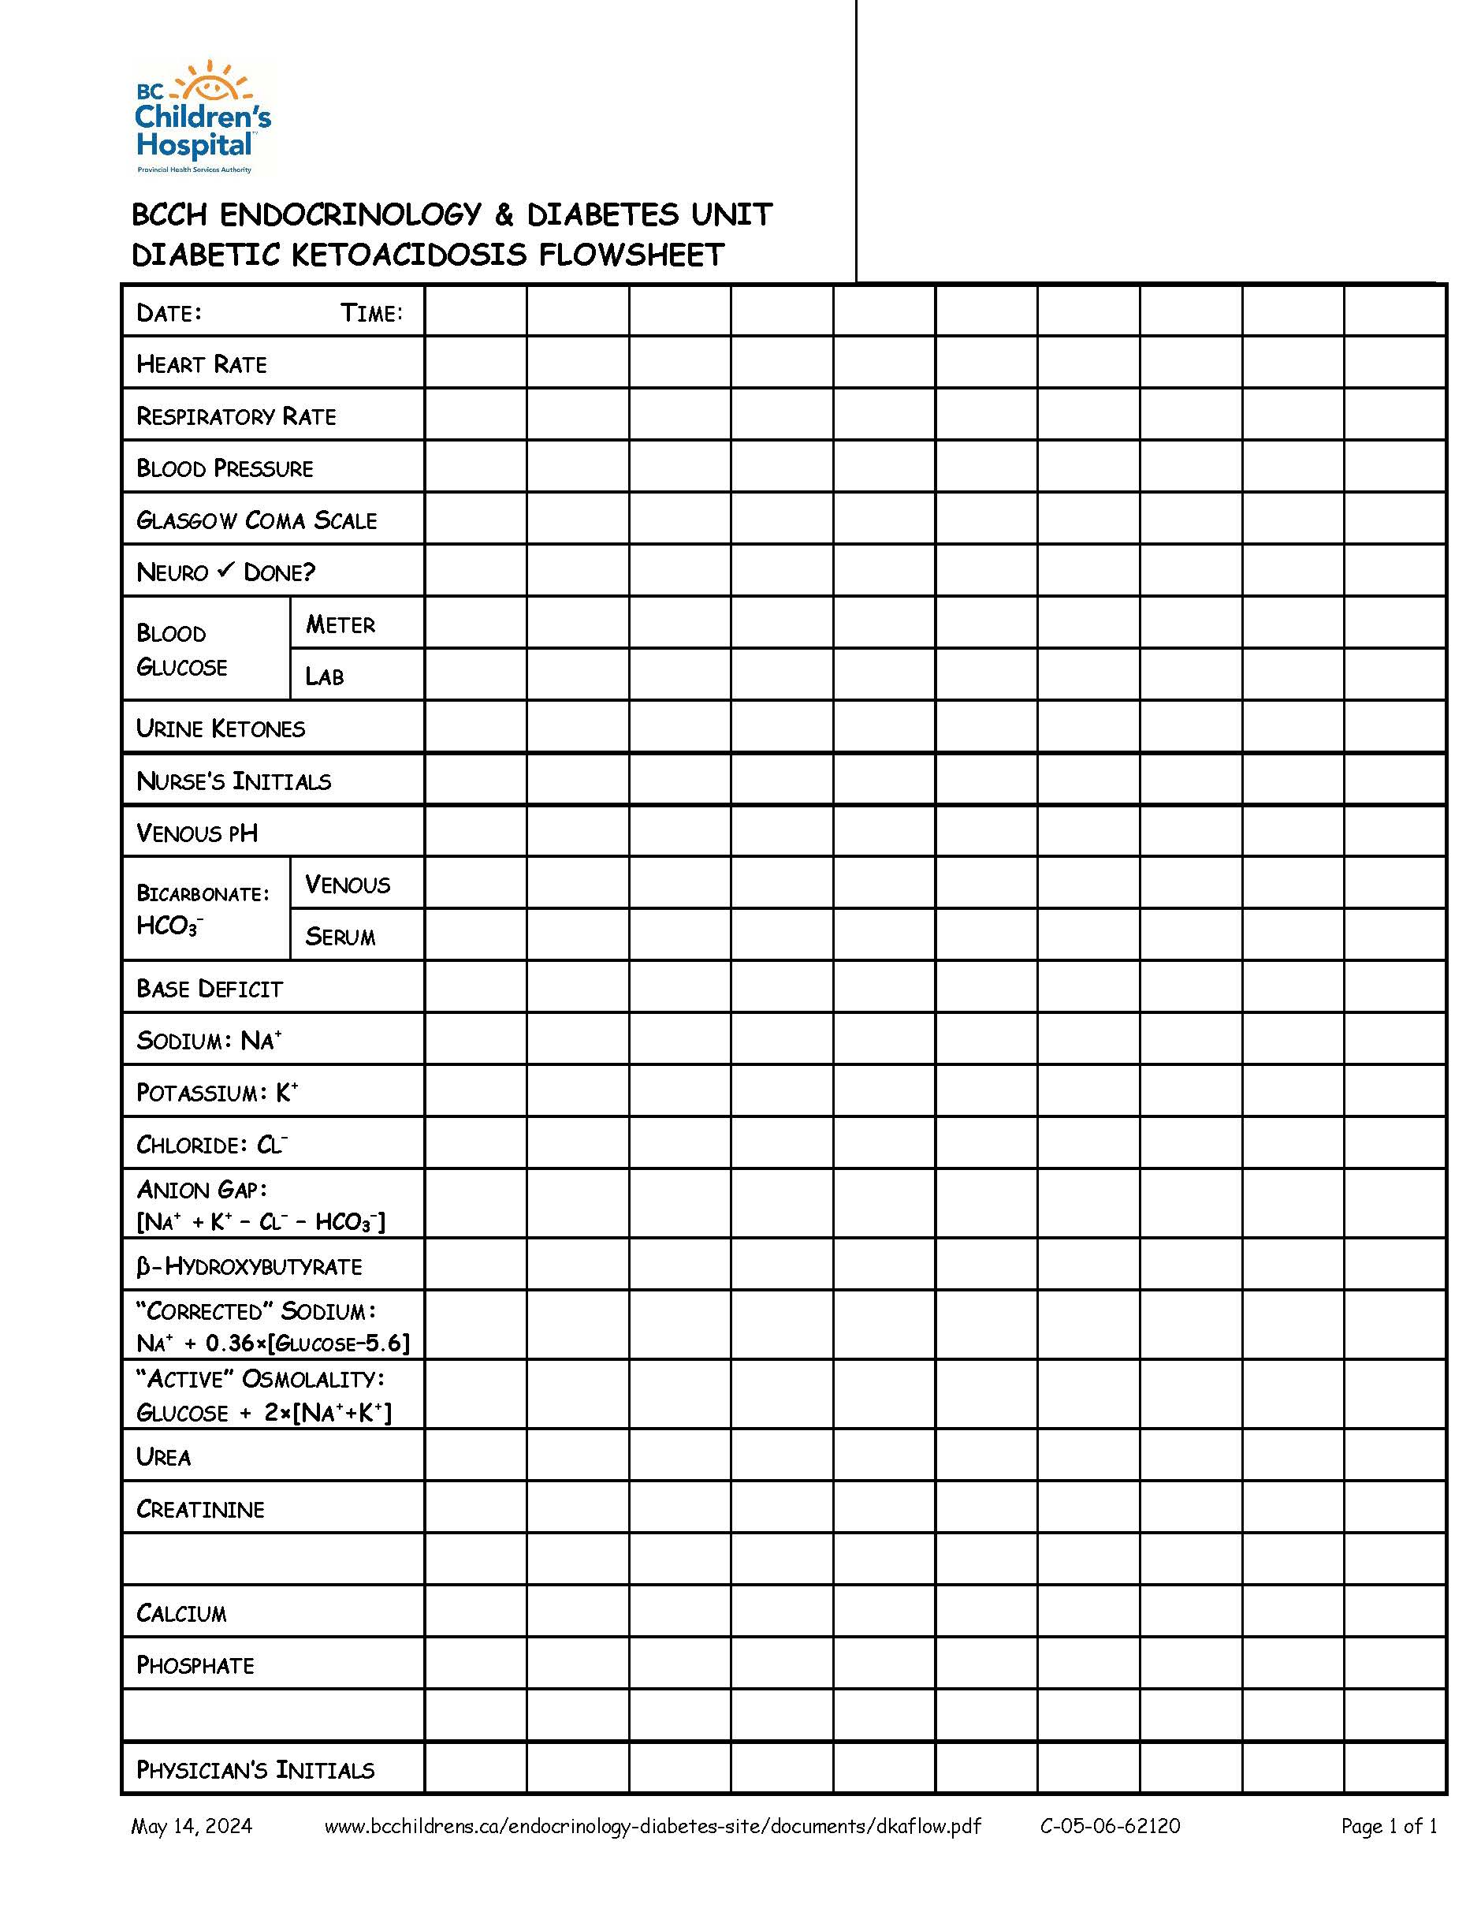
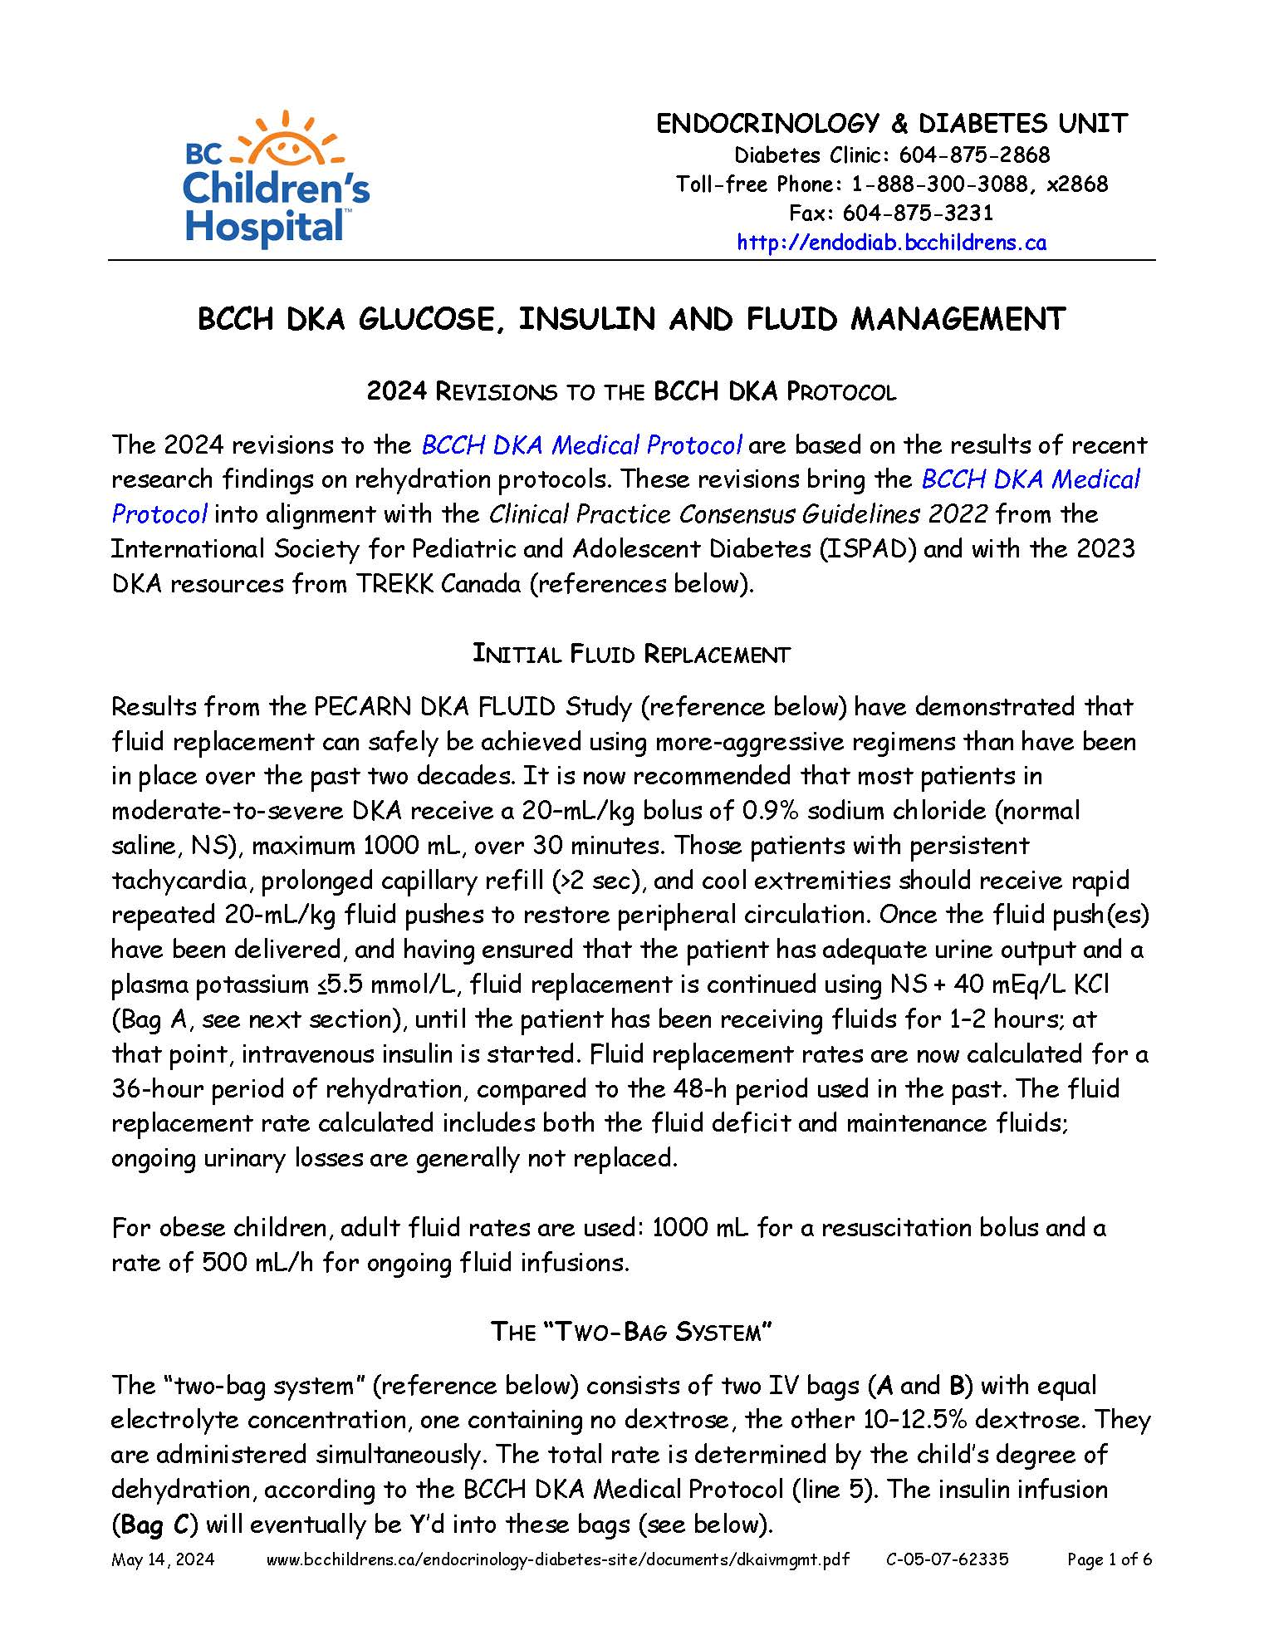
DKA MEDICAL DOCUMENTS

Slide 16
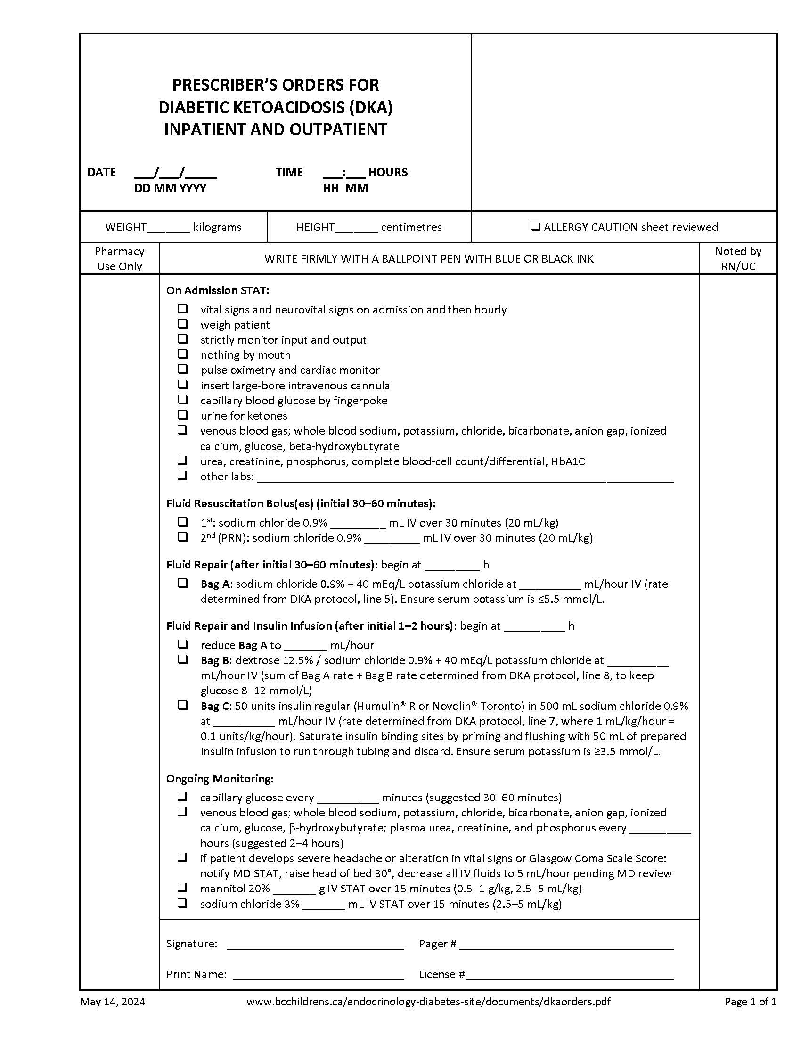
SAMPLE PRESCRIBER ORDERS FOR DKA

Slide 17
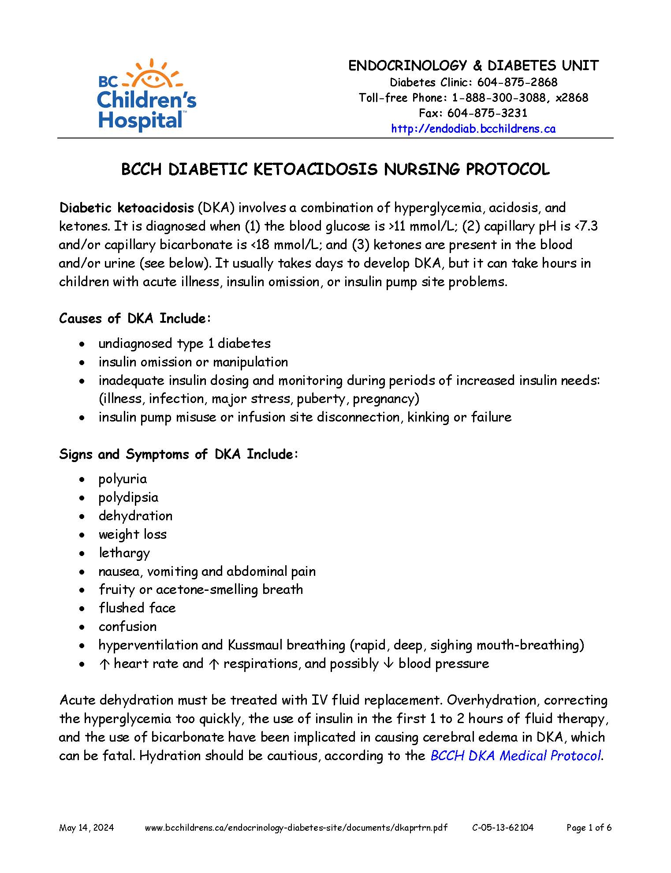
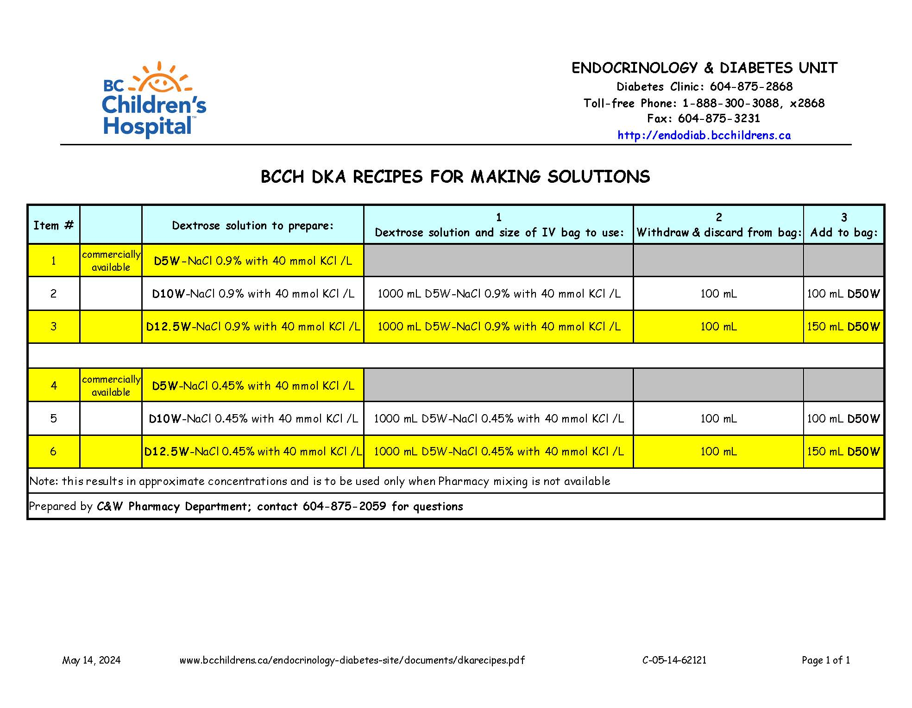
DKA NURSING DOCUMENTS

Slide 18
BCCH DKA PROTOCOL 2024: TIMELINE
on admission: weight, vitals, assessment and stabilization
first 20–30 minutes: fluid resuscitation
30 min–36 h:
fluid replacement
insulin infusion (no sooner than 60 min)
addition of glucose
throughout:
careful monitoring, reassessment
titration of fluids, electrolytes, glucose, insulin

Slide 19
INITIAL ER MANAGEMENT
ABC’s and GCS
weigh patient
insert large-bore IV
check chemistries, CBG, urine/blood ketones
evaluate dehydration
think about underlying illness (infection, etc.)

Slide 20
EVALUATING DEHYDRATION
best:
prolonged capillary refill (>1.5–2 sec)
abnormal skin turgor
abnormal respiratory pattern
also:
no tears
weak pulses
cool extremities
↓ HR
poor:
dry mouth
urine output
BP
weight

Slide 21
ESTIMATING DEHYDRATION (% body weight)
 | INFANTS | KIDS
MILD | 5% | 3%
MODERATE | 10% | 6%
SEVERE | 15% | 9 (10)%

Slide 22
CAUTIONS IN APPROACH
fluid and electrolyte imbalances in patients presenting in DKA can be quite disparate:
kid has been drinking only water all day
kid has been drinking juice all day
kid has been drinking pop all day
kid has been vomiting all day
kid has been having chicken soup all day
some kids may have insulin on board
many patients present with an element of hyperglycemic hyperosmolar state and/or hypernatremic dehydration

Slide 23
BCCH PROTOCOL: 1st 20–30 MINUTES
give 1st bolus of NS 20 mL/kg (max 1000 mL) IV over 20–30 min
patients with persistent tachycardia, prolonged capillary refill (>2 sec), and cool extremities should receive rapid repeated 20-mL/kg fluid pushes to restore peripheral circulation

Slide 24
BCCH PROTOCOL: 30 MINUTES–36 HOURS
begin even rehydration over 36 h, estimating 10% dehydration:
5–10 kg BW: 6.5 mL/kg/h
10–20 kg BW: 6 mL/kg/h
20–40 kg BW: 5 mL/kg/h
>40 kg BW: 4 mL/kg/h, max 500 mL/h
start with NS + 40 mEq KCl/L, assuming patient is urinating and plasma K⁺ is ≤5.5 mmol/L

Slide 25
BCCH PROTOCOL: 30 MINUTES–36 HOURS
at 60–120 min after start of 1st fluid bolus, begin insulin infusion:
ensure plasma K⁺ is ≥3.5 mmol/L
0.05–0.1 Units/kg/h
consider 0.05 U/kg/h for pH >7.15
0.5–1 mL/kg/h of 50 units Regular insulin in 500 mL NS
when BG is <25 mmol/L and falling >5 mmol/L/h, add dextrose to IV fluids using the “two-bag” method

Slide 26
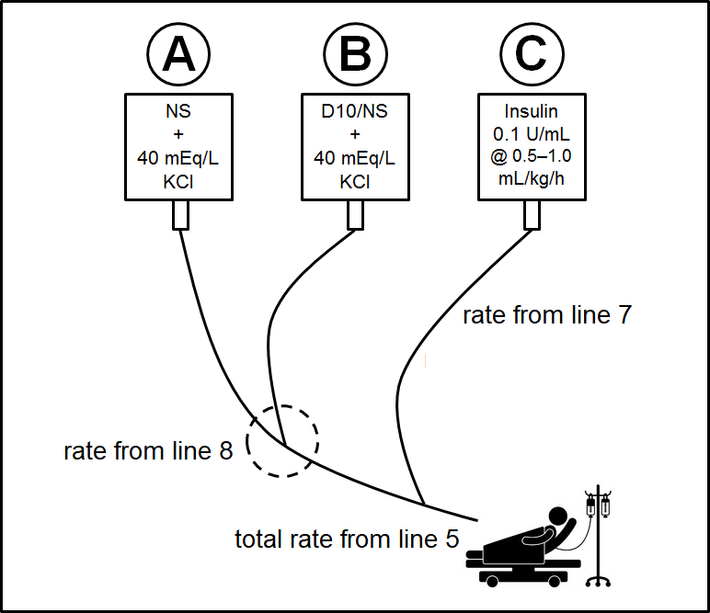
“TWO-BAG” METHOD

Slide 27
BCCH PROTOCOL: 30 MINUTES–36 HOURS
aim to keep BG in the ~8–12 mmol/L range by titrating the rates of the two Bags A and B
a general rule is to make changes of approximately 10–20% of the total rate every hour
if the patient’s BG is lower than desired, despite maximal dextrose infusion from Bag B, you may (in order of safety):
cut the insulin infusion rate by ~25%, provided the acidosis is correcting
give the patient a small amount (1–2 mL/kg) of juice or 2–4 dextrose tablets (being mindful of the overall fluid balance)
change the insulin Bag C to D10/NS
in institutions with intensive-care capabilities, consider placing a central line and using a higher concentration of dextrose (e.g. D20) in Bag B

Slide 28
BCCH PROTOCOL: 30 MINUTES–36 HOURS
at 4–6 h after initial fluids and if corrected Na⁺ is ≥140 mmol/L, stable or increasing:
switch Bag A to ½NS + 40 mEq/L KCl
switch Bag B to D10/½NS + 40 mEq/L KCl
if unable to get K⁺ >3.5 mmol/L with IV fluids: consider PO/NG KCl
may give 50% of K⁺ as phosphate (order by the mmol of K⁺)
may prevent ensuing hyperchloremia, but no clear evidence of benefit
bicarbonate: rarely if ever needed

Slide 29
ONGOING MONITORING
BG by meter q30–60 min (may need lab BG if >30 mmol/L)
Na⁺, K⁺, Cl⁻, HCO₃⁻, anion gap, urea, creatinine, venous pH q2–4 h
Ca²⁺, Mg²⁺, P_{i} q2–4 h if giving phosphate
β-hydroxybutyrate (preferably) or urine ketones q2–4 h
neurovital signs/GCS q30–60 min
corrected Na⁺ = [measured Na⁺ + 0.36×(BG−5.6)]
active osmolality = [BG + 2×(Na⁺+K⁺)]

Slide 30
URINE vs BLOOD KETONES
URINE KETONES | β-HYDROXYBUTYRATE
negative | ≤0.5 mmol/L
trace (<0.5 mmol/L) | 0.6–0.9 mmol/L
small (1+, 0.5 mmol/L) | 1.0–1.4 mmol/L
moderate (2+, 1.5 mmol/L) | 1.5–2.4 mmol/L
large (3+, 4 mmol/L) | 2.5–2.9 mmol/L
very large (4+, 8 mmol/L) | ≥3.0 mmol/L

Slide 31
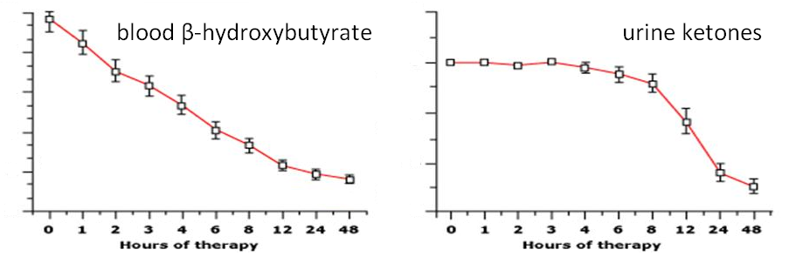
FALL IN BLOOD VS. URINE KETONES IN DKA

Slide 32
ACUTE KIDNEY INJURY
DKA should be considered a multiple organ dysfunction syndrome
kids in DKA have a high risk (64%) of acute kidney injury (AKI)
use Schwartz formula to calculate expected baseline creatinine:
EBC (µmol/L) = 36.5 × height (cm)/120
measured creatinine 1.5–1.99× EBC = Stage 1
measured creatinine 2–2.99× EBC = Stage 2
measured creatinine ≥3× EBC = Stage 3
some creatinine assays have cross-reactivity with ketones!

Slide 33
MECHANISMS OF CEREBRAL INJURY
vasogenic edema: leakage across altered BBB
hypoxia
cerebral hypoperfusion/reperfusion
neuroinflammation (IL-6, etc.)
ketones (altered BBB)
hypocapnia (↓ cerebral blood flow)
other possible factors:
role of Na⁺–H⁺ antiporter-3 (insulin) and Na⁺–K⁺–Cl⁻ cotransporter-1
continued absorption of H₂O from GI tract
vasopressin, atrial natriuretic peptide
cellular edema: osmotic shifts across cell membrane

Slide 34
CEREBRAL INJURY: MORTALITY
can be present at diagnosis before treatment
usually occurs in first 12–24 hours of treatment
DKA still has ~0.5–1% risk of cerebral injury
~25% mortality rate, ~35% serious morbidity rate
70–80% of diabetes-related deaths in kids <12
greatest contributor (~50%) to mortality of DKA, not hyperglycemia or shock
subclinical CI with subtle sequelae may be frequent in DKA

Slide 35
BASELINE RISK FACTORS FOR CI
? infants and young children
new-onset (3.3% vs. 0.23% in known pts)
long-standing symptoms
↑ plasma Na⁺, ↓ plasma Na⁺
↓ p_{a}CO₂ (even adjusting for pH), ↓ pH (most acidotic)
↑ plasma urea, ↑ plasma K⁺, ↑ hematocrit (most dehydrated)
“sickest looking”?

Slide 36
TREATMENT-RELATED RISK FACTORS FOR CI
too-rapid fall in “corrected Na⁺”
Na⁺ + [0.36 × (glucose – 5.6)]
failure of uncorrected Na⁺ to rise
too-rapid fall in “active osmolality”
glucose + [2 × (Na⁺ + K⁺)]
bicarbonate therapy
early (<60 min) insulin Rx or large insulin boluses
? fluids ≥4 L/m²/24 h or ≥50 mL/kg in 1st 4 h

Slide 37
CEREBRAL INJURY: DIAGNOSIS 1
92% sensitivity, 4% false-positive:
1 diagnostic criterion
2 major criteria
1 major and 2 minor criteria
neuroimaging not required
diagnostic criteria:
abnormal motor or verbal response to pain
decorticate or decerebrate posture
cranial nerve palsy (especially III, IV, and VI)
abnormal neurogenic respiratory pattern (e.g., grunting, tachypnea, Cheyne–Stokes respiration, apneusis)

Slide 38
CEREBRAL INJURY: DIAGNOSIS 2
major criteria:
altered mentation, confusion, fluctuating level of consciousness
sustained heart rate deceleration (decrease more than 20 beats per minute) not attributable to improved intravascular volume or sleep state
age-inappropriate incontinence
minor criteria:
vomiting
headache
lethargy or not easily arousable
diastolic BP >90 mm Hg
age <5 years

Slide 39
CEREBRAL INJURY: TREATMENT
elevate head of bed
reduce fluid rate by ⅓, but avoid hypotension
administer hyperosmolar agent:
mannitol 20% 0.5–1 g/kg (2.5–5 mL/kg) IV over 15 min
NaCl 3% 2.5–5 mL/kg IV over 15 min
intubate if pending respiratory failure
mild hyperventilation, avoid hypocapnia
no known role for dexamethasone
early Dx and Rx improve outcome

Slide 40
OTHER COMPLICATIONS OF DKA
hypokalemia*, hypocalcemia, hypomagnesemia, hypophosphatemia*
hyperchloremic acidosis
hypoglycemia
peripheral venous*, dural sinus, basilar artery thrombosis
pulmonary embolism*, pulmonary edema*, pneumothorax, aspiration pneumonia*, ARDS
rhabdomyolysis*
acute pancreatitis*
intracranial hemorrhage, cerebral infarction
acute kidney injury*

Slide 41
HYPERGLYCEMIC HYPEROSMOLAR STATE
diagnosis:
hyperglycemia: glucose >33.3 mmol/L
hyperosmolality: effective plasma osmolality >320 mOsm/kg
small ketonuria (0–1+) or β-hydroxybutyrate <1.5 mmol/L
no significant acidosis: pH_{art} >7.30 or pH_{ven} >7.25 or HCO₃– >15 mmol/L
obtundation, combativeness, seizures (~50%)
seen in T2D, obese, blacks
also seen in T1D drinking lots of pop
can have mixture of DKA and HHS

Slide 42
HHS vs. DKA
↑ hyperosmolality, ↑ hyperglycemia
↑ dehydration, ↑ fluid Rx needed
↑ electrolyte loss
↓ acidosis, ↑ HCO₃–
may not need much or any insulin
↑ risk of shock, thrombosis, rhabdomyolysis
↓ risk of cerebral injury

Slide 43
TREATING HHS
assume 12–15% dehydration
fluids: 20 mL/kg NS, then balance Na⁺ content:
intravascular needs vs. lowering osmolality
K⁺: 20 mEq/L KCl + 20 mEq/L KPhos
insulin: 0.025 U/kg/h if BG won’t ↓ with fluids
lower Na⁺ by ~0.5 mmol/L/h
lower glucose by ~3–5 mmol/L/h

Slide 44
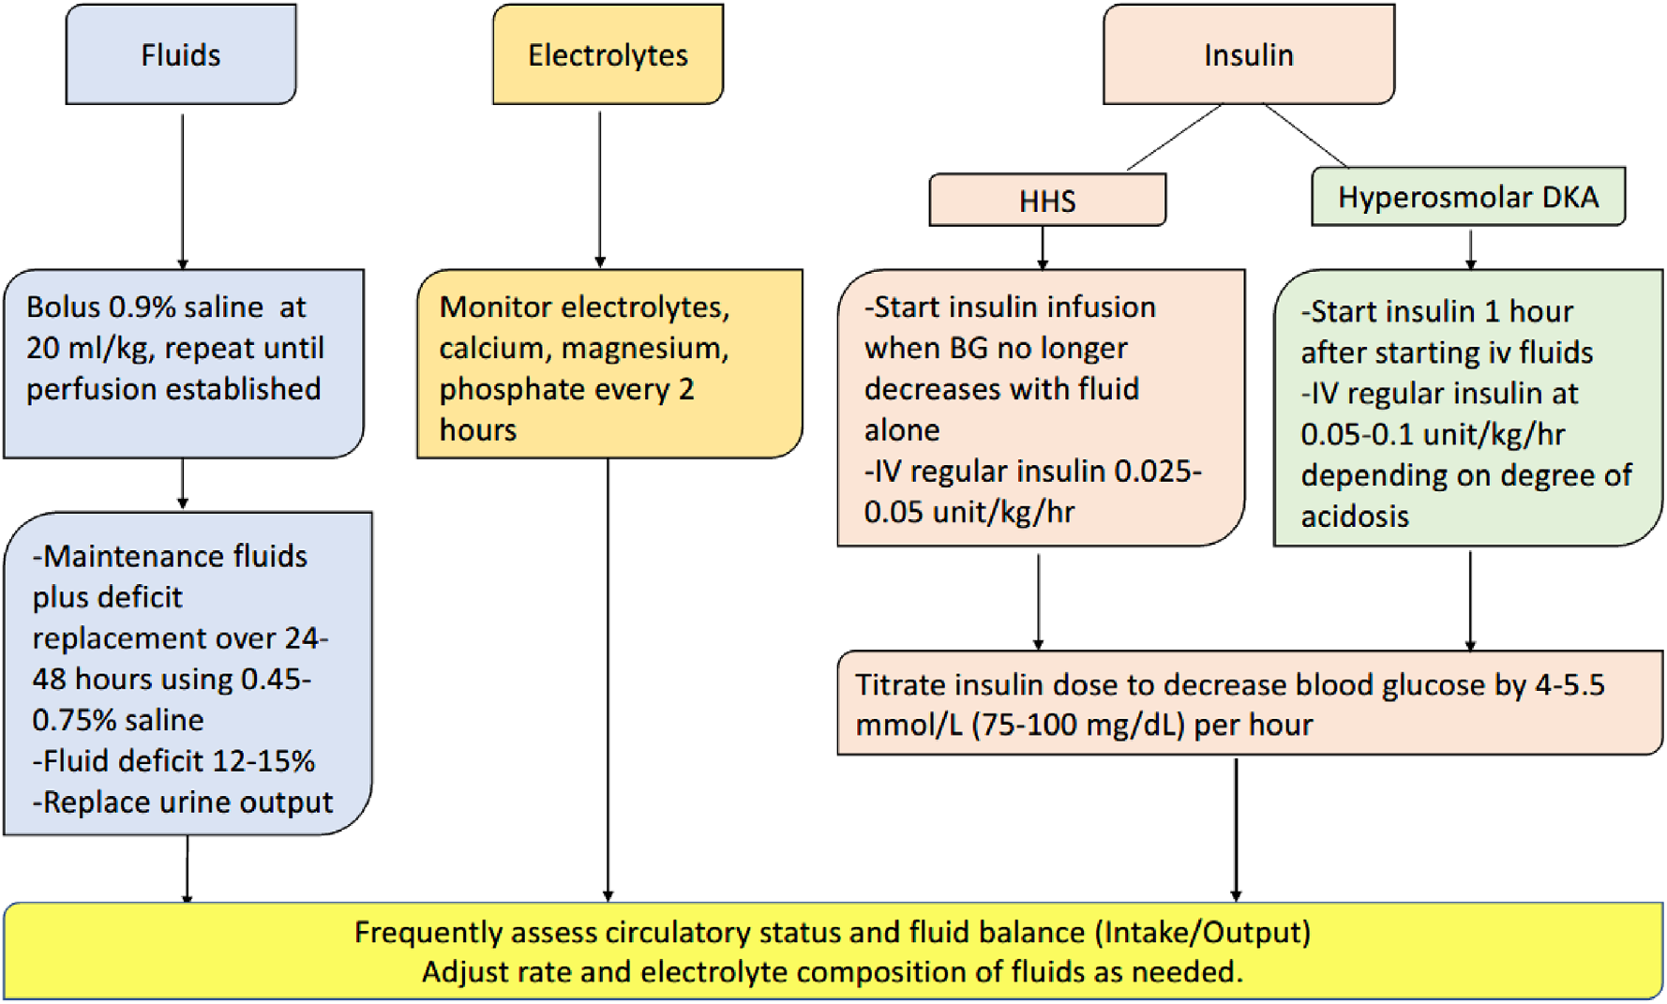
ISPAD HHS ALGORITHM

Slide 45
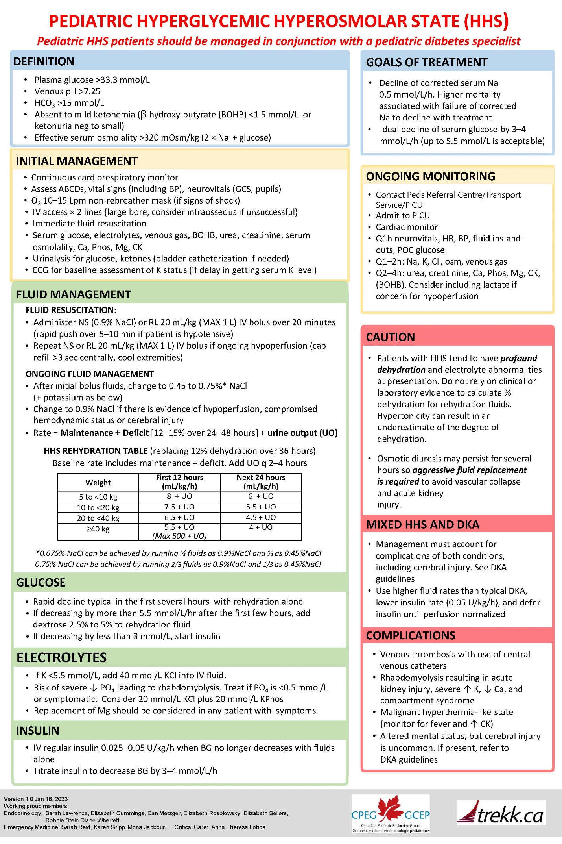
CPEG HHS ALGORITHM 2023

Slide 46
RECURRENT DKA
most often seen in:
very small kids with GI illness
unsupervised kids
non-compliant teens
insulin pump site problems
nearly all cases of recurrent DKA are preventable!
get an A1C!

Slide 47
DKA PREVENTION (BC PEDIATRIC SOCIETY)

Slide 48
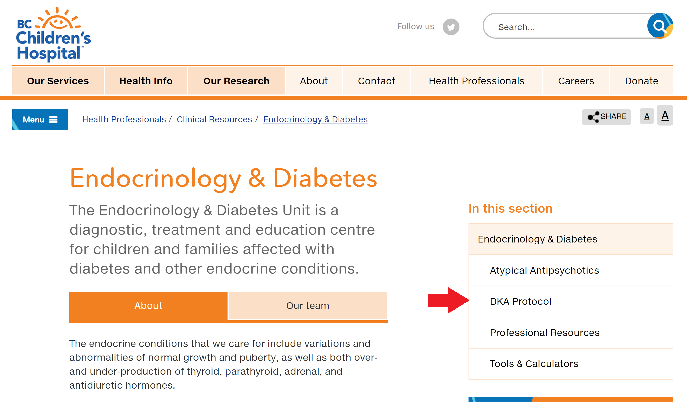
EDU WEBSITE
http://endodiab.bcchildrens.ca

Slide 49
REFERENCES
Wherrett DK, Ho J, Huot C, Legault L, Nakhla N, Rosolowsky E. Diabetes Canada Clinical Practice Guidelines Expert Committee. Diabetes Canada 2018 Clinical practice guidelines for the prevention and management of diabetes in Canada: Type 1 diabetes in children and adolescents. Can J Diabetes 2018;42(Suppl 1):S234-S246.
Glaser N, Fritsch M, Priyambada L, Rewers A, Cherubini V, Estrada S, Wolfsdorf JI, Codner E. ISPAD Clinical Practice Consensus Guidelines 2022: Diabetic ketoacidosis and hyperglycemic hyperosmolar state. Pediatric Diabetes 2022:23(7):835–856.
Kuppermann N, Ghetti S, Schunk JE, Stoner MJ, Rewers A, McManemy JK, Myers SR, Nigrovic LE, Garro A, Brown KM, Quayle KS, Trainor JL, Tzimenatos L, Bennett JE, DePiero AD, Kwok MY, Perry CS 3rd, Olsen CS, Casper TC, Dean JM, Glaser NS; PECARN DKA FLUID Study Group. Clinical trial of fluid infusion rates for pediatric diabetic ketoacidosis. NEJM 2018;378(24):2275-2287.
Grimberg A, Cerri RW, Satin-Smith M, Cohen P. The “two bag system” for variable intravenous dextrose and fluid administration: Benefits in diabetic ketoacidosis management. J Pediatr 1999;134(3):376–378.
Translating Emergency Knowledge for Kids (TREKK Canada): http://trekk.ca.
Glaser N, Kuppermann N. Fluid treatment for children with diabetic ketoacidosis: how do the results of the PECARN FLUID Trial change our perspective? Pediatr Diabetes 2019;20(1):10–14.
BC Children’s Hospital ePOPS (Electronic Policies, Order Sets, Procedures and Standards): http://policyandorders.cw.bc.ca.

